Slide 1



Double-Double laminates for improved impact and post-impact resistance
Dongwon Lee
Avin Vijay

Slide 2
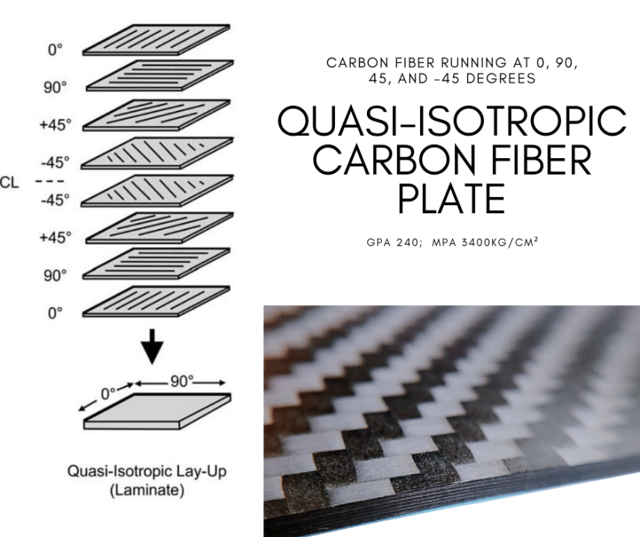
Quasi-isotropic laminates
What is quasi-isotropic laminates?
Quasi-isotropic
Quasi means “almost” and Isotropic means that material that behaves the same in all direction.
Why do we need Quasi-isotropic?
Design
Only using 0, 45, -45, 90 orientation
Lacking rational basis– extension of isotropic mechanics
Weight penalty

Slide 3
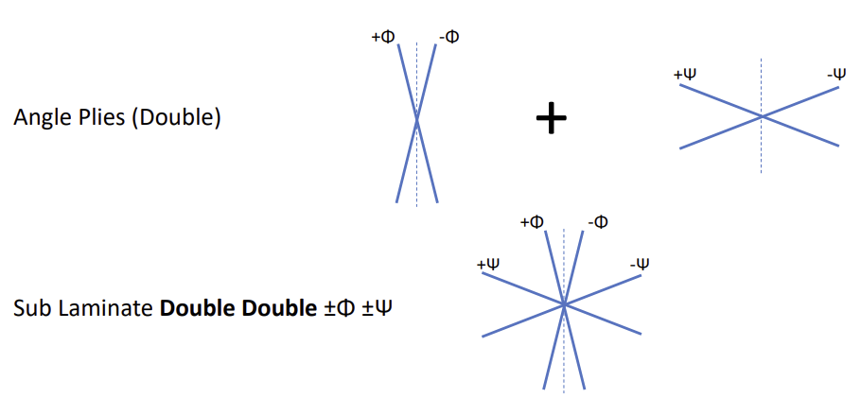
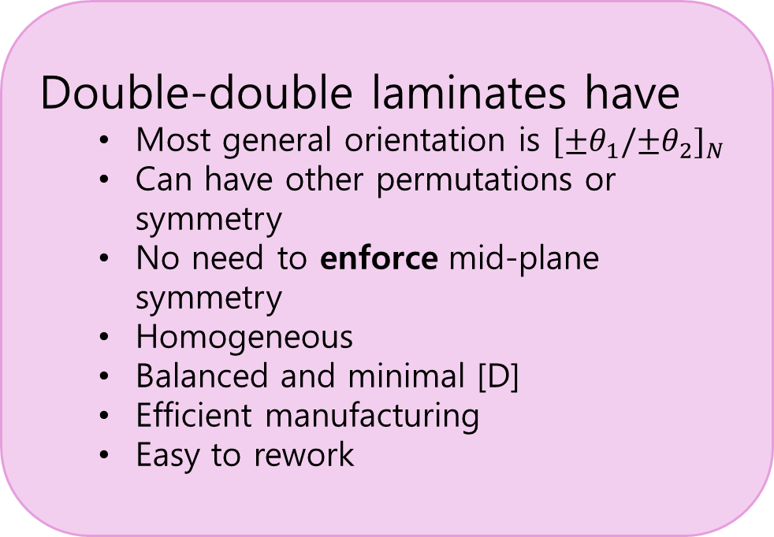
Double-Double (DD) Laminates
What are double-double laminates and its benefits?
Double-double laminates have
Most general orientation is ${[±θ_{1}/{±θ}_{2}]}_{N}$
Can have other permutations or symmetry
No need to enforce mid-plane symmetry
Homogeneous
Balanced and minimal [D]
Efficient manufacturing
Easy to rework

Slide 4
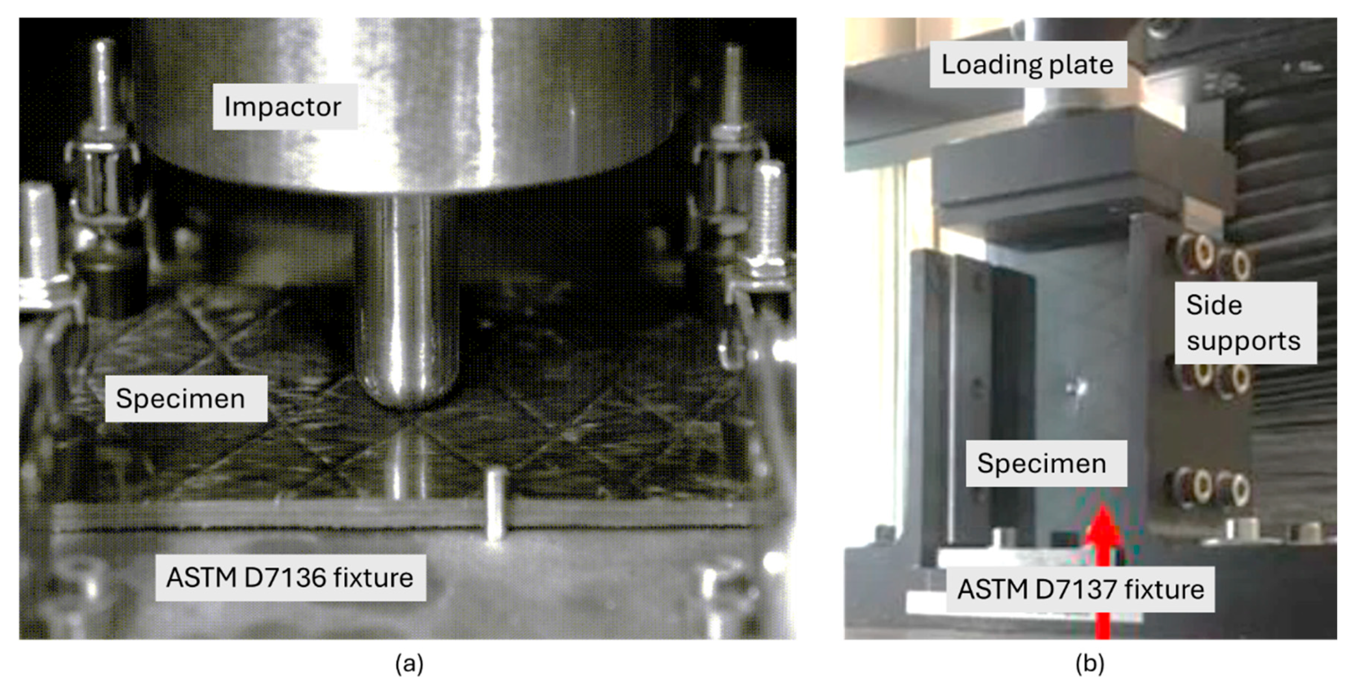
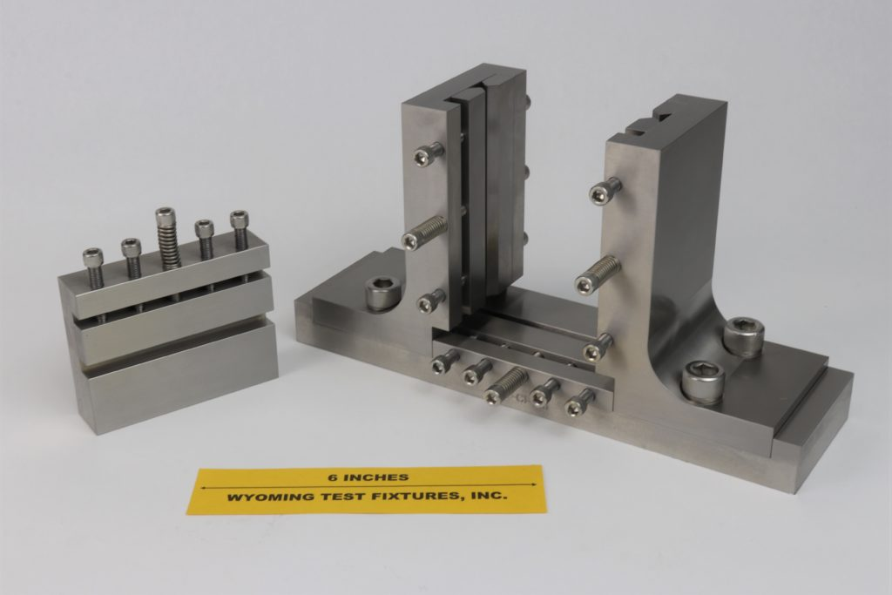
Impact and Compression After Impact
Low velocity impact/ BVID- typical to occur in service like tool drops.
The CAI test simulates real-world damage scenarios that could occur in service.
The goal is to evaluate how much compressive load a composite laminate can carry after sustaining such damage
Two stages
Impact stage
Compression stage

Slide 5
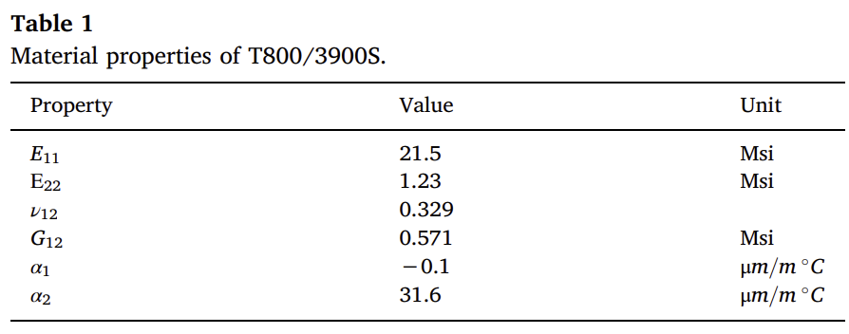

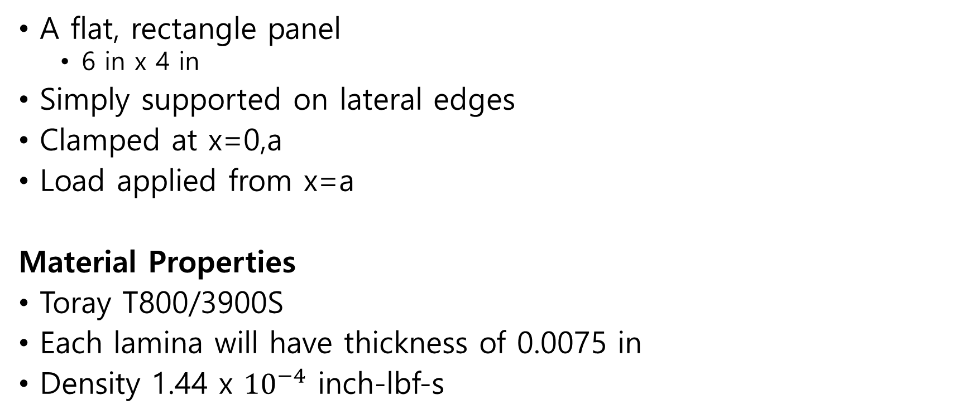







Mechanics Problem
$$y,w$$
A flat, rectangle panel
6 in x 4 in
Simply supported on lateral edges
Clamped at x=0,a
Load applied from x=a
Material Properties
Toray T800/3900S
Each lamina will have thickness of 0.0075 in
Density 1.44 x ${10}^{−4}$ inch-lbf-s
$$ss$$
$$N_{x}$$
$$b$$
$$ss$$
$x,$u
$$z,w$$
$$a$$

Slide 6
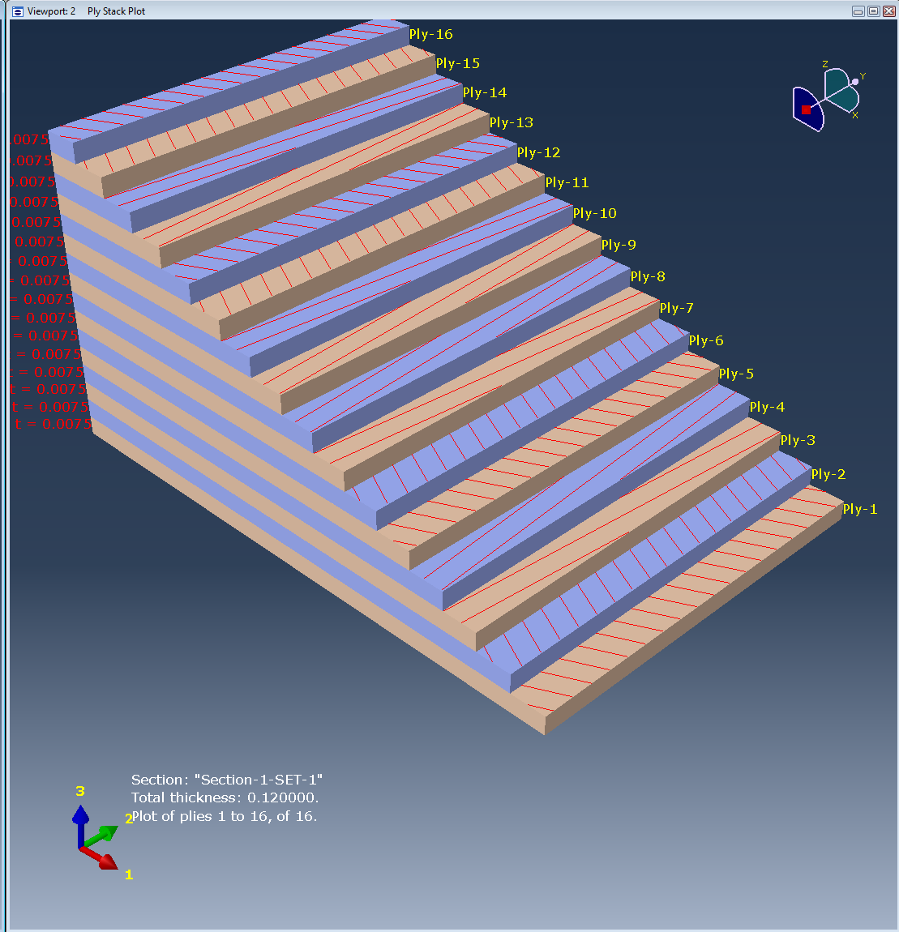


$DD$and $D\overline{D}$ Orientations
Total of 16 plies
5 different cases
Case 1 : ${[±θ_{1}/{±θ}_{2}]}_{2s}$
Case 2 : ${[±θ_{1}/{±θ}_{2}]}_{4}$
Case 3 : ${[{±θ}_{1}/{±θ}_{2}{/∓θ}_{1}/{∓θ}_{2}]}_{2}$
Case 4 : $[{{(±θ}_{1}/{±θ}_{2})}_{2}/$ ${{(∓θ}_{1}/{∓θ}_{2})}_{2}]$
Case 5 : ${[{±θ}_{1}/{±θ}_{2}{/∓θ}_{1}/{∓θ}_{2}]}_{s}$

Slide 7
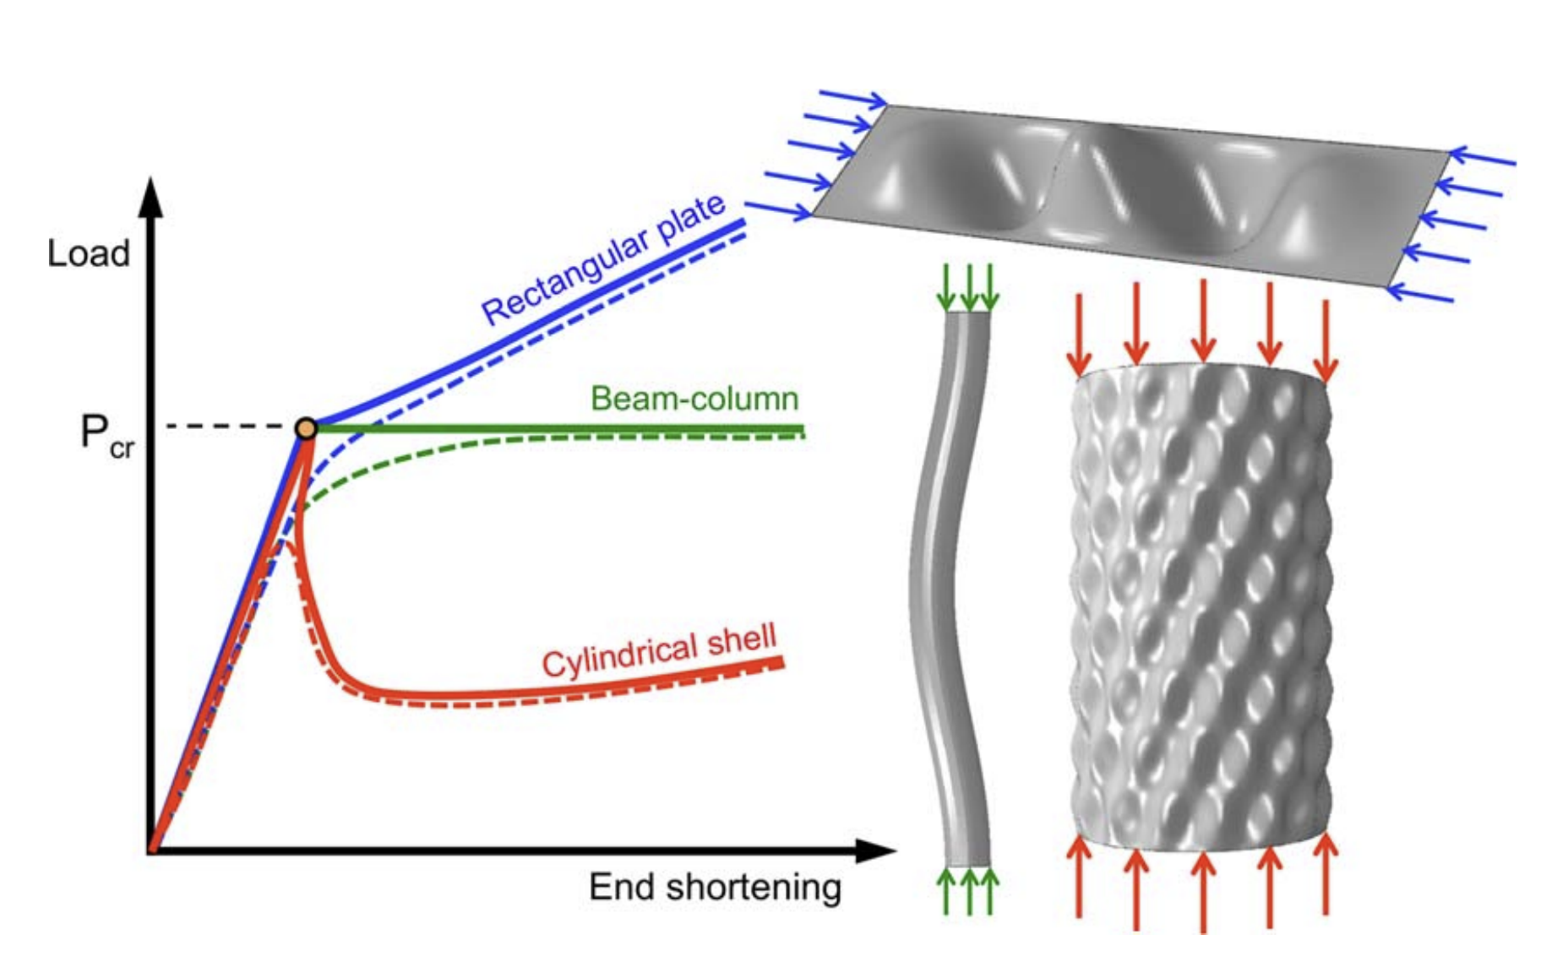
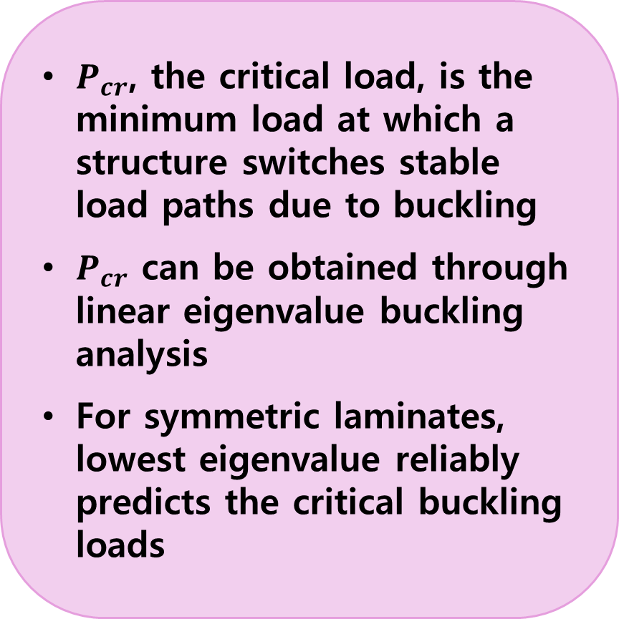
Buckling vs. Transition Loads
$P_{cr}$, the critical load, is the minimum load at which a structure switches stable load paths due to buckling
$P_{cr}$ can be obtained through linear eigenvalue buckling analysis
For symmetric laminates, lowest eigenvalue reliably predicts the critical buckling loads
Load vs end-shortening
Solid line
Ideal (perfect) structure
Theoretical equilibrium path is symmetric
Dashed line
Real (imperfect) structure
Realistic response with small initial imperfections or load eccentricity

Slide 8
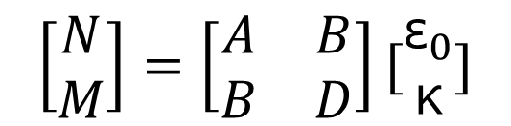
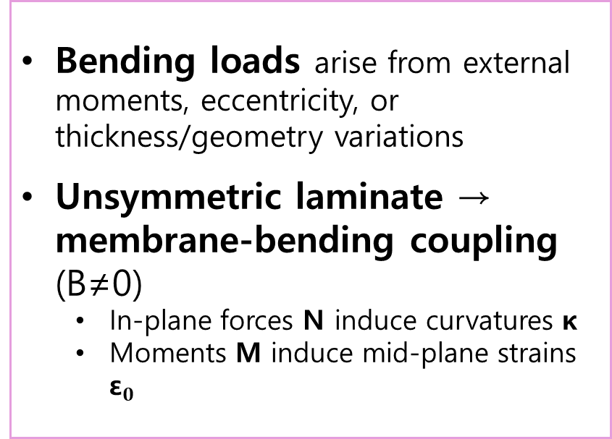
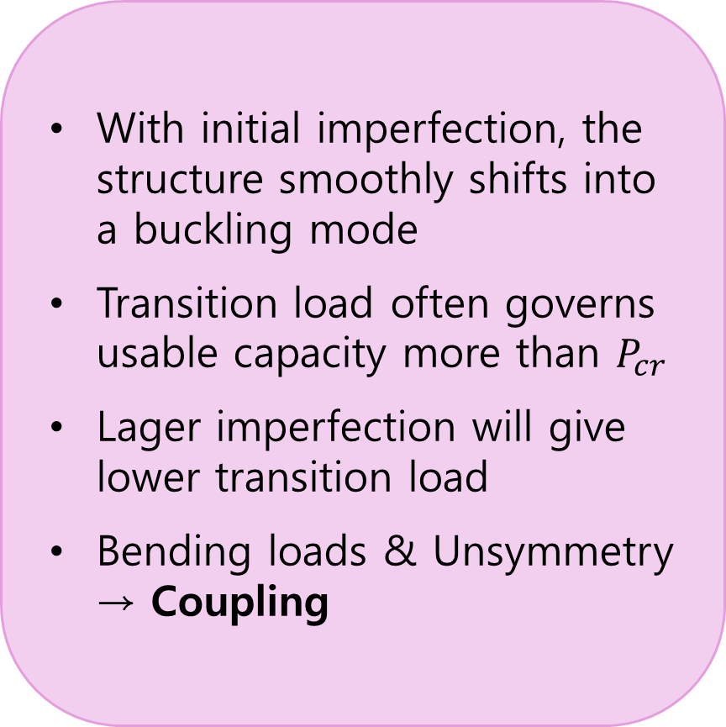
Transition Loads
With initial imperfection, the structure smoothly shifts into a buckling mode
Transition load often governs usable capacity more than $P_{cr}$
Lager imperfection will give lower transition load
Bending loads & Unsymmetry → Coupling
Bending loads arise from external moments, eccentricity, or thickness/geometry variations
Unsymmetric laminate → membrane-bending coupling (B≠0)
In-plane forces N induce curvatures κ
Moments M induce mid-plane strains ${\text{ε}}_{0}$
$$\left[\begin{matrix}N \\ M\end{matrix}\right]=\left[\begin{matrix}A & B \\ B & D\end{matrix}\right][\begin{matrix}{\text{ε}}_{0} \\ \text{κ}\end{matrix}]$$

Slide 9
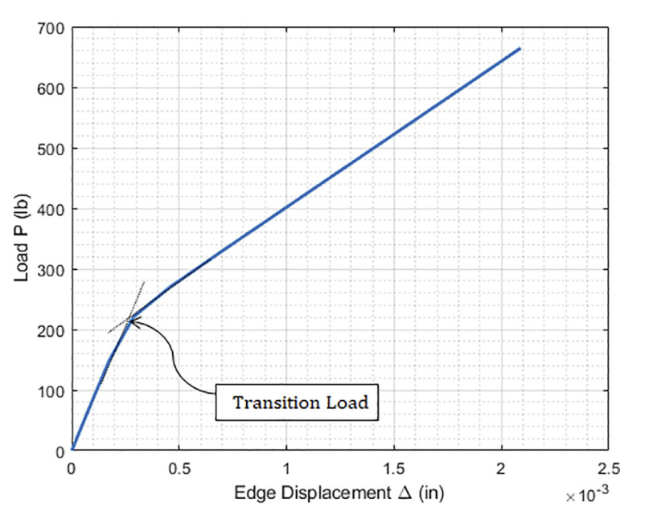
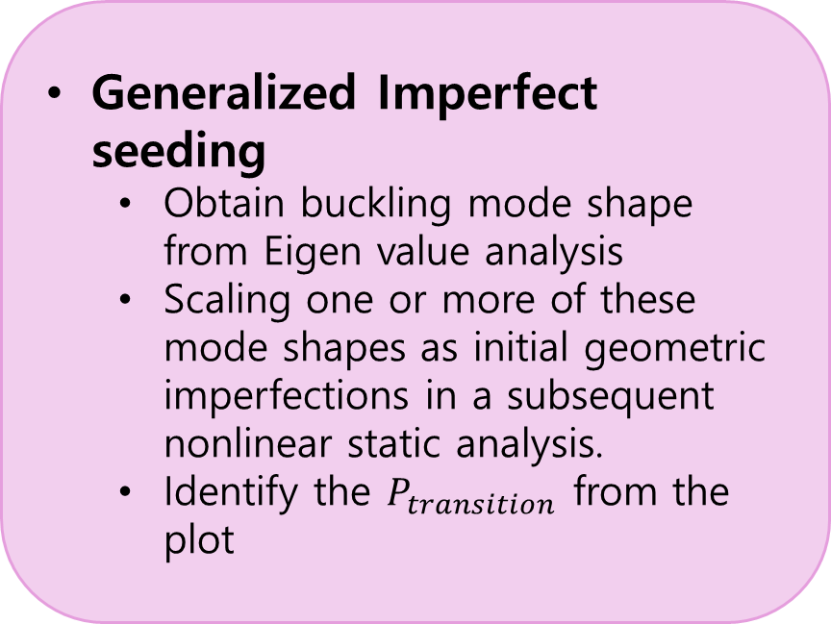
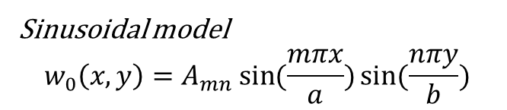
Imperfection seeding
What if some layups are not symmetric?
If it is non-symmetric, we cannot use eigenvalue.
It overestimates the critical load
Miss the actual buckling mode
B matrix in stiffness matrix is not zero
Generalized Imperfect seeding
Obtain buckling mode shape from Eigen value analysis
Scaling one or more of these mode shapes as initial geometric imperfections in a subsequent nonlinear static analysis.
Identify the $P_{transition}$ from the plot
Sinusoidal model
$$w_{0}\left(x,y\right)=A_{mn}\sin{(\frac{mπx}{a})}\sin{(\frac{nπy}{b})}$$

Slide 10
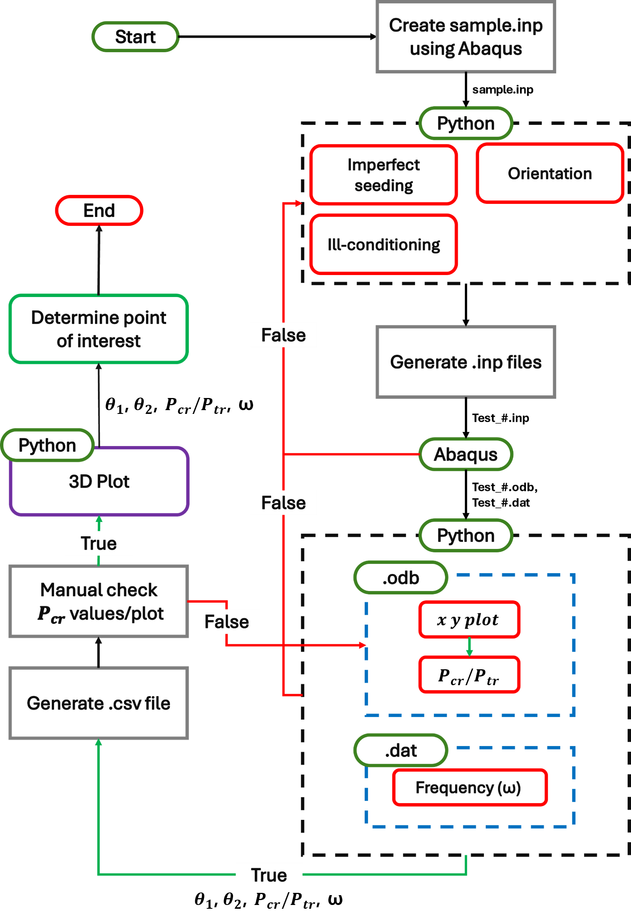

Optimization workflow
Stage 0 : Create sample input file
B.C.s
Material Properties
Stage 1 : Python Pre-Process
Imperfection seeding
Orientation
Stage 2 : .inp Generation & Abaqus Run
Stage 3 : .dat & .odb
$P_{tr}$ or $P_{cr}$
ω
Stage 4 : Post-Processing & QC
Check if $P_{tr}$ is correct by looking at the xy plot
Stage 5 : Output & Data Management
Generate .csv file to save data

Slide 11
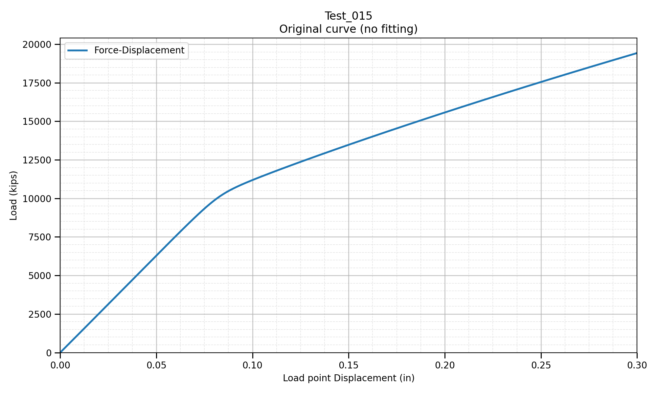

Type 1: Imperfection perfect
Type 1: Imperfection perfect
Characteristics
Initial stiffness is nearly linear
Post-transition stiffness is also approximately linear
Knee point is clear and stable
Decision: Transition load = intersection of the initial and post-transition fitted lines.
= $P_{tr}$

Slide 12
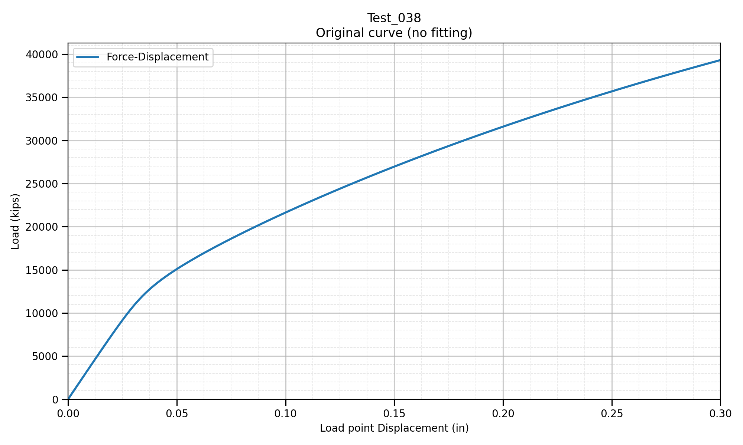
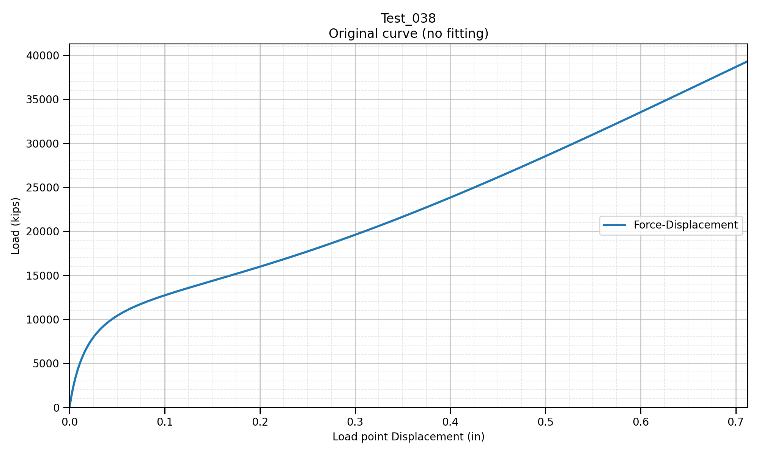


Type 2: Imperfection imperfect - 1
Type 2: Imperfection imperfect - 1
U3 displacement plot
= $P_{tr1}$
= $P_{tr2}$
Characteristics
Initial stiffness is nearly linear
Post-transition stiffness curves
Knee point is somewhat unclear
Need to look at u3 displacement plot
Decision: Transition load = (intersection of the initial and post-transition fitted lines from force plot + intersection of initial and post-transition fitted lines from u3 plot) / 2

Slide 13
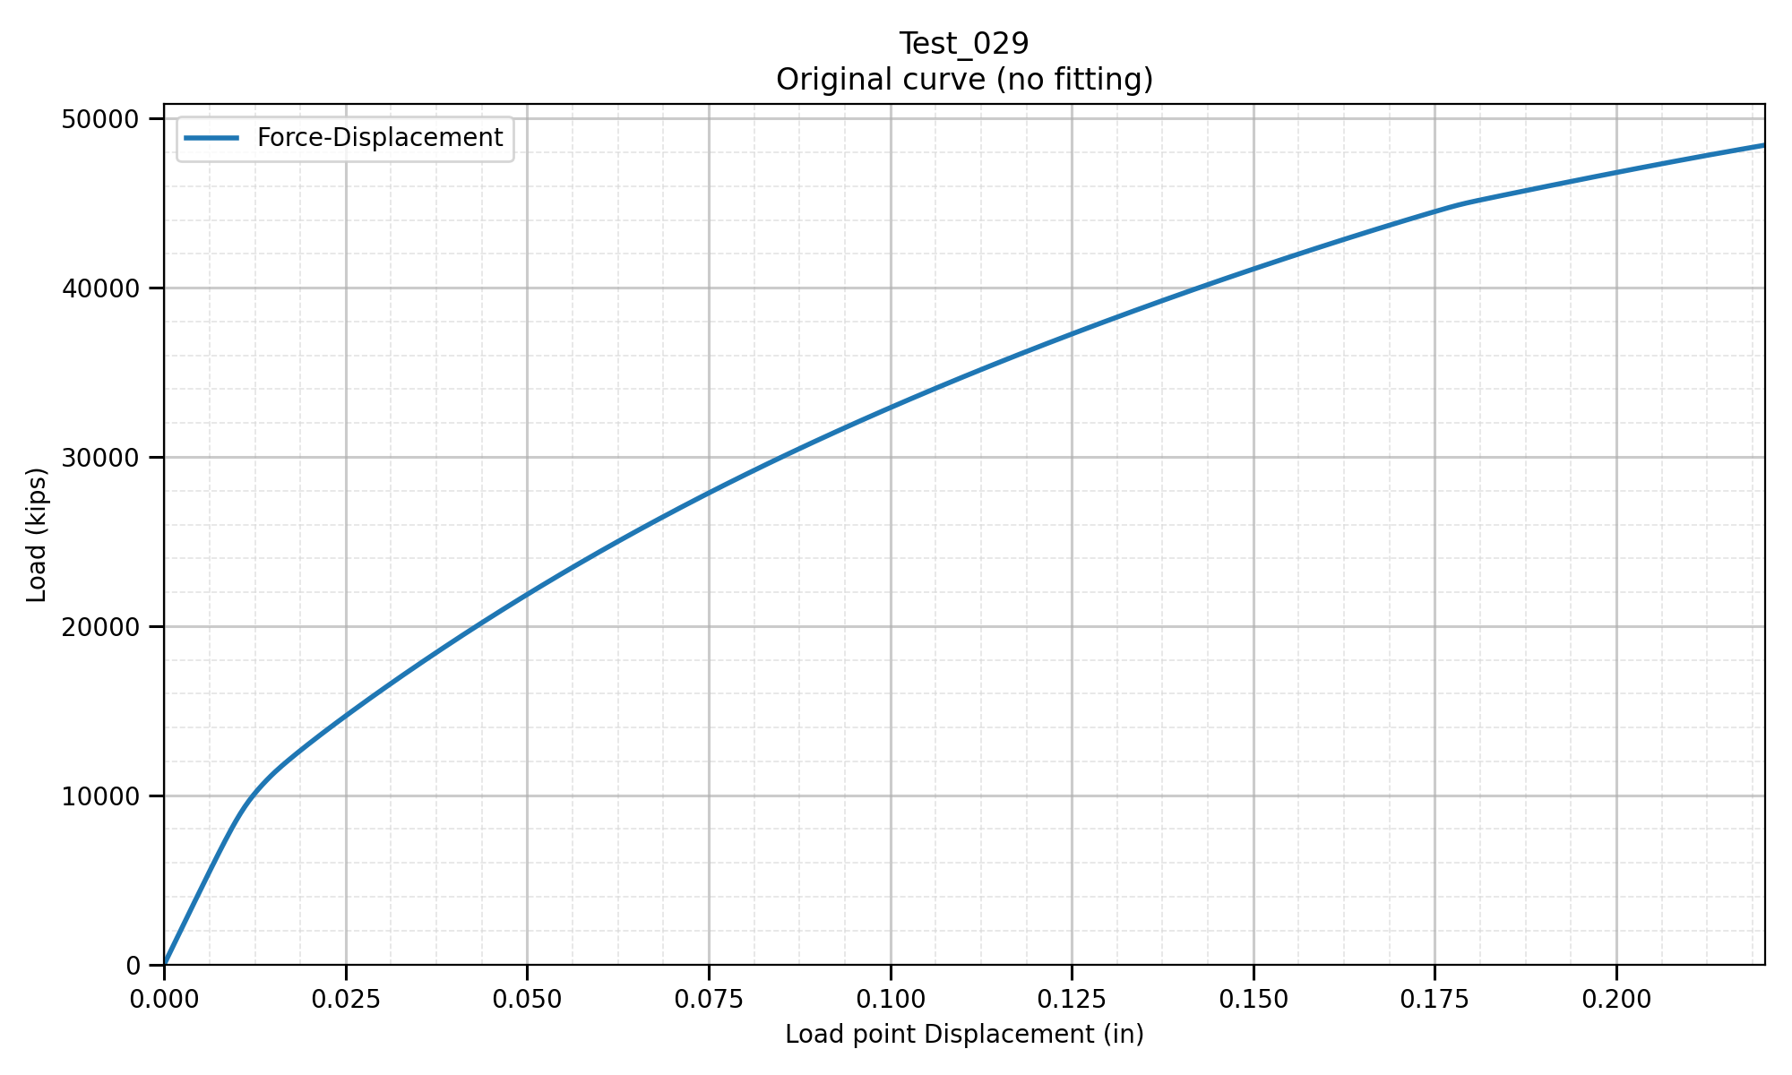
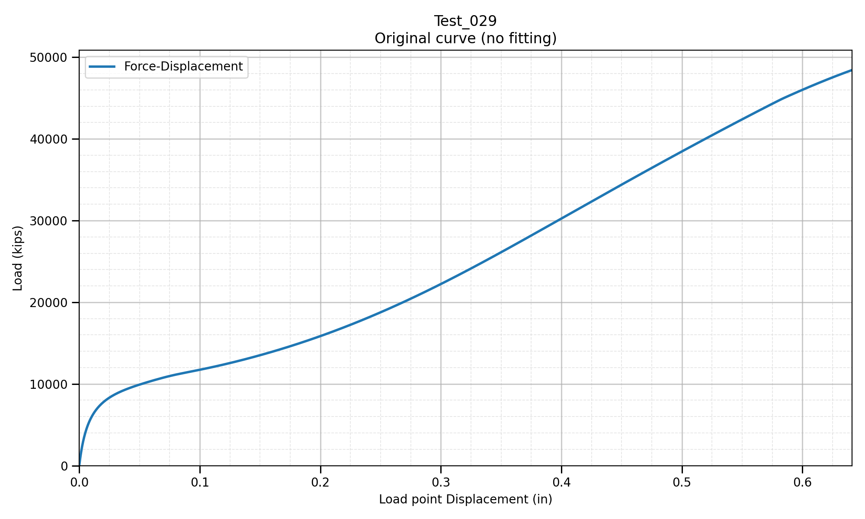
Type 3: Imperfection imperfect - 2
Type 3: Imperfection imperfect - 2
U3 displacement plot
= $P_{tr1}$
= $P_{tr2}$
Characteristics
Initial stiffness is nearly linear
Post-transition stiffness curves heavily
Knee point is somewhat unclear
Need to look at u3 displacement plot
Decision: Transition load = intersection of initial and post-transition fitted lines from u3 plot

Slide 14
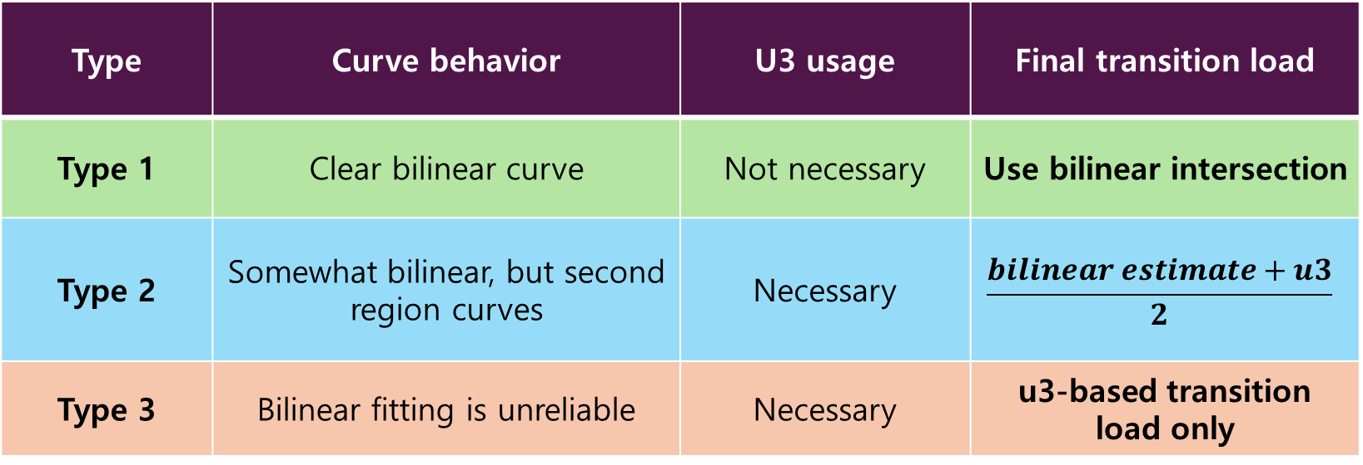
Three different types and selection rule
Type | Curve behavior | U3 usage | Final transition load
Type 1 | Clear bilinear curve | Not necessary | Use bilinear intersection
Type 2 | Somewhat bilinear, but second region curves | Necessary | $$\frac{bilinear estimate+u3}{2}$$
Type 3 | Bilinear fitting is unreliable | Necessary | u3-based transition load only
Check force-displacement curve
Clear Bilinear?
No
Unclear knee point with somewhat curve second region
No
Second region curves heavily?
Yes
Yes
Yes
Type 1
Type 2
Type 3

Slide 15
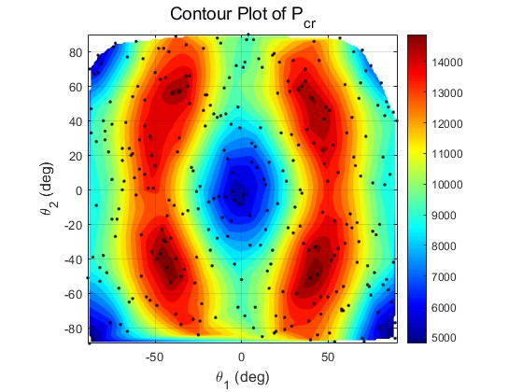
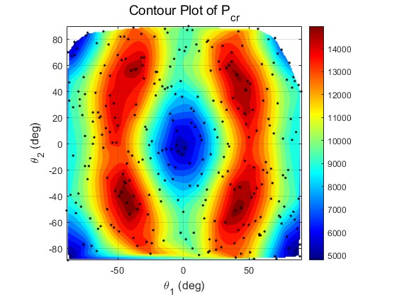
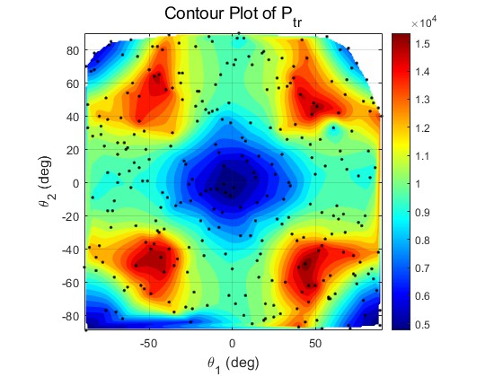
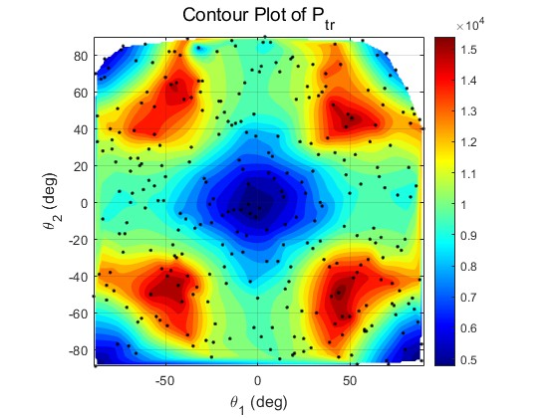
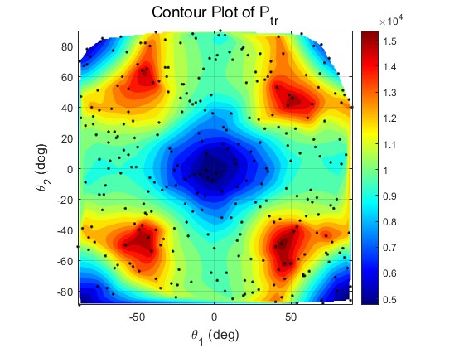
Result Overview: 5 Cases, 2 Surface Patterns
Pattern I: Case 1 & 5
Key contrast
+28.93% vs Quasi
Similar twin-ridge /
Center basin pattern
Case 3 best / quasi = 15916.5 / 12344.8
Design implication
±45º-type angles dominates
Case 1
Case 5
High-performing regions appear away from $θ_{1}$=$θ_{2}$=0º
Pattern II: Case 2, 3 & 4
4-corner peak structure with a low center region
Case 2
Case 3
Case 4

Slide 16




Pattern I: Case 1 & 5
Shared visual pattern
Center basin + Side ridges
Both surfaces favor nonzero ±θ combinations
Highest $P_{cr}$ case 1
Case 1
Case 5
15,386.6
Case 5 slightly improves the peak while preserving the same response shape
$θ_{1}$=40.53º, $θ_{2}$=-50.32º
Highest $P_{cr}$ case 5
Quasi | Benchmark | 12,344.8
Case 1 | Best | 15,386.6
Case 5 | Best | 15,484.1
Case 5 | vs Quasi | +25.41%
Case 5 | vs [0/0] | +186.42%
Case 5 | vs Case 1 | +0.63%
15,484.1
$θ_{1}$=-43.13º, $θ_{2}$=-44.92º

Slide 17

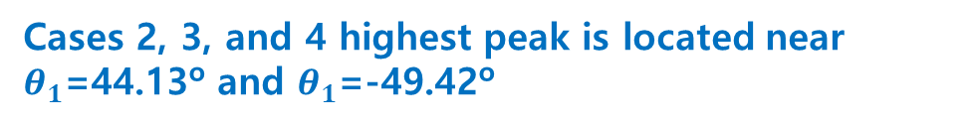
Pattern II: Case 2, 3 & 4
Case 2
Case 3
Case 4
Cases 2, 3, and 4 highest peak is located near $θ_{1}$=44.13º and $θ_{1}$=-49.42º
Shared visual pattern
4-corner peak with a low center region
Quasi | Benchmark | 12,344.8
Case 2 | Best | 15,880.6
Case 3 | Best | 15,916.5
Case 4 | Best | 15,908.5
Case 3 | vs Quasi | +28.93%
Case 3 | vs [0/0] | +194.42%
Case 3 | vs Case 2 | +0.22%
Case 3 | vs Case 4 | +0.05%
All surfaces favor nonzero ±θ combinations
$P_{cr}$ range
15.88k – 15.91k
Small variation among cases

Slide 18


Ranking: Optimized Layups vs. Benchmarks
Highest $P_{tr}$
Case 3: 15,916.5
$θ_{1}$=44.13º, $θ_{2}$=-49.42º
Improvement vs quasi
+28.93%
15916.5 compare with 12344.8
Improvement vs Case 5
+2.79%
15916.5 compare with 15484.1
All optimized layups cluster around 15.8k, while [0/0] and [90/90] are much lower. Therefore, the main result is not only which case wins, but that the optimized ±θ angle family consistently outperforms the basic baselines.

Slide 19
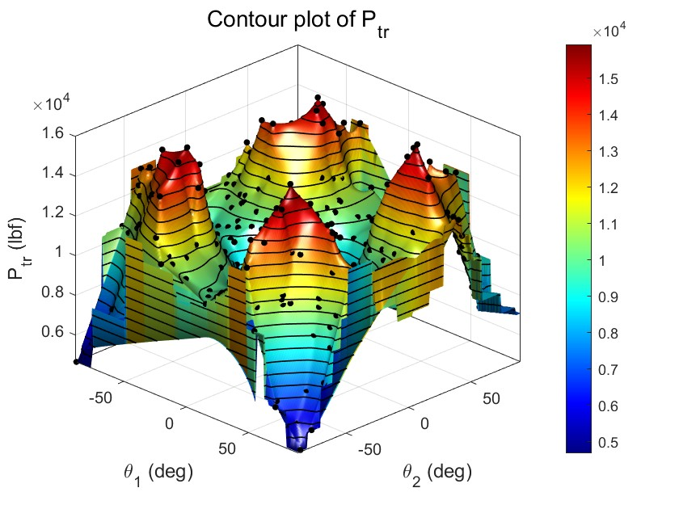
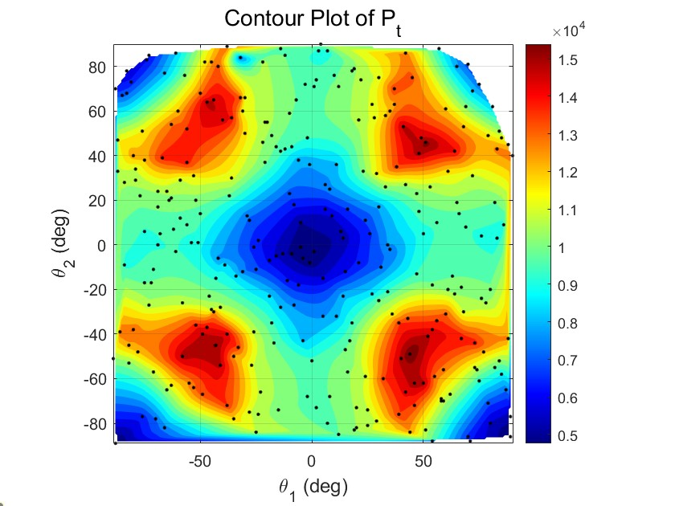



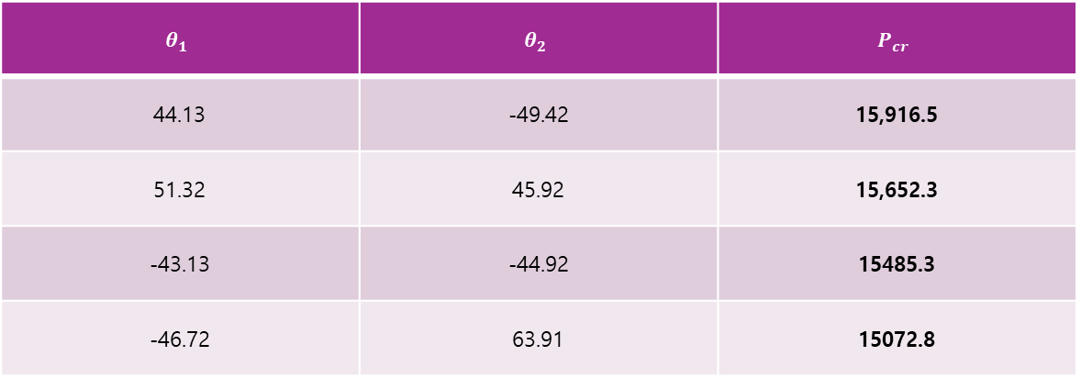
Best Result : Case 3
Best $P_{cr}$
vs [0/0]
vs Quasi
15916.5 lbs
+194.42%
+28.93%
$θ_{1}$=44.13º, $θ_{2}$=-49.42º
2.94x higher than baseline
1.28x higher than quasi-isotropic
Top candidate list
$$θ_{1}$$ | $$θ_{2}$$ | $$P_{cr}$$
44.13 | -49.42 | 15,916.5
51.32 | 45.92 | 15,652.3
-43.13 | -44.92 | 15485.3
-46.72 | 63.91 | 15072.8
The high-$P_{cr}$ region occurs around ±45°-type asymmetric combinations, not near the [0/0] or [90/90] baselines.

Slide 20
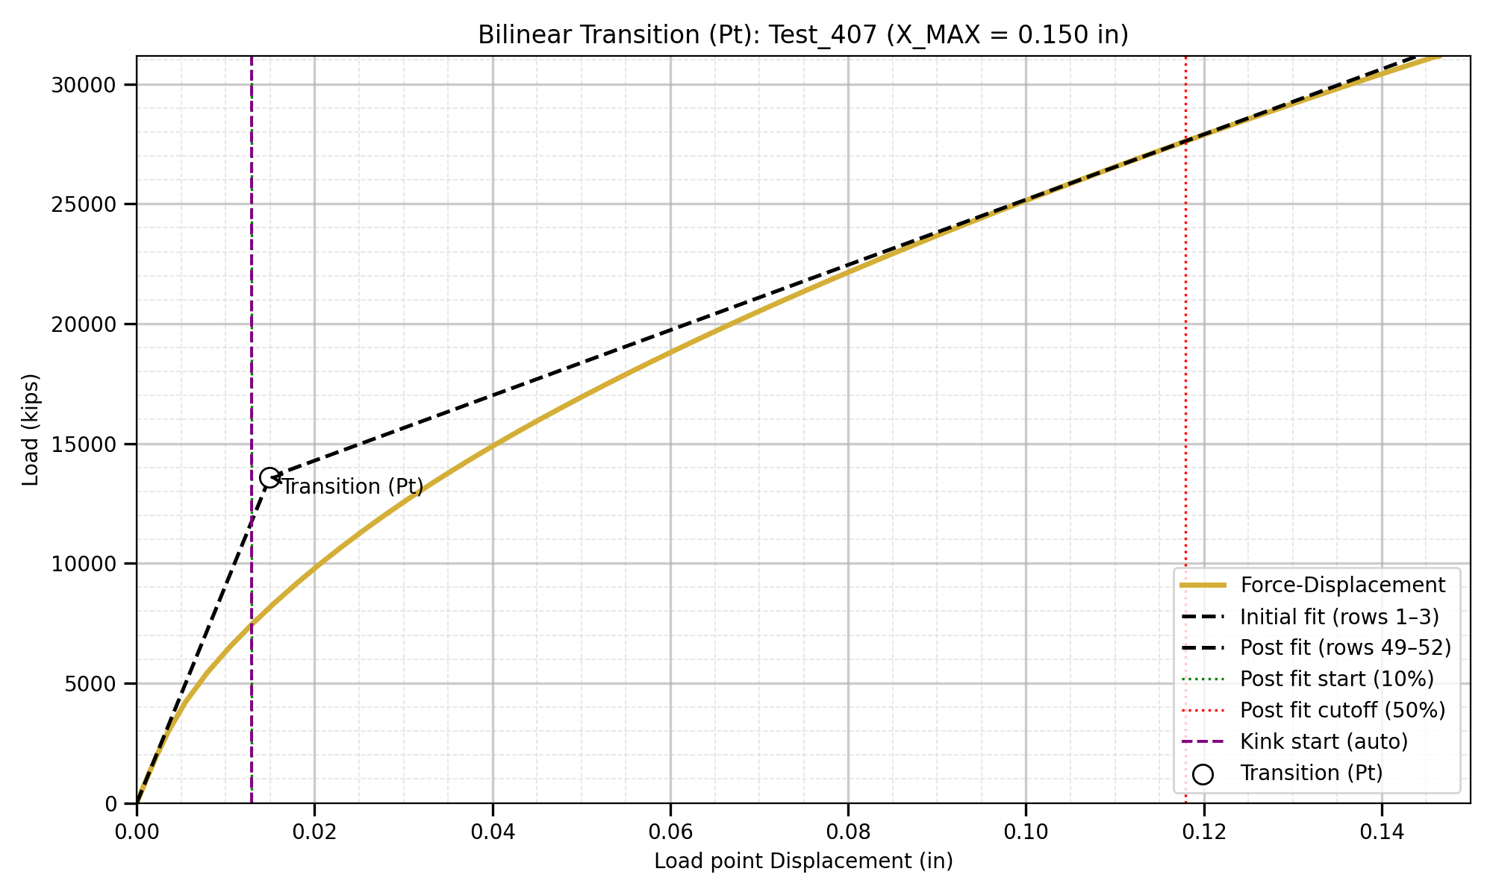
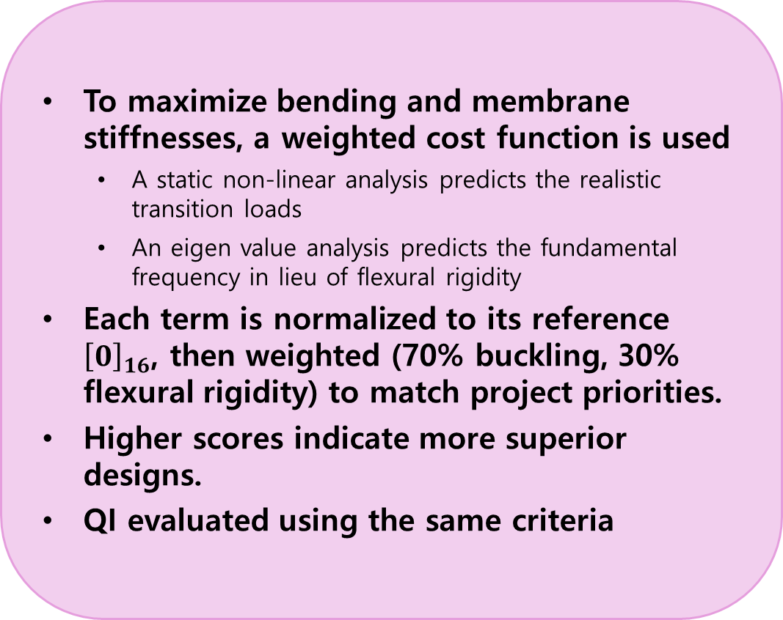
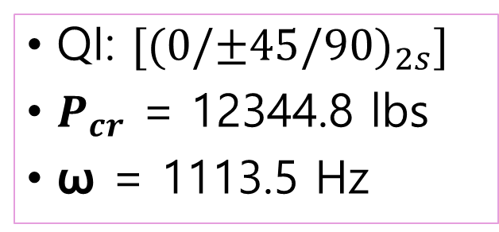
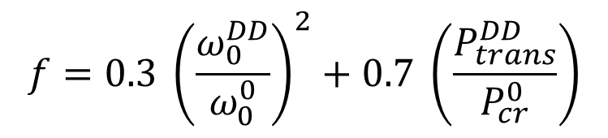
Cost function evaluation
$$f=0.3 {\left(\frac{ω_{0}^{DD}}{ω_{0}^{0}}\right)}^{2}+0.7 \left(\frac{P_{trans}^{DD}}{P_{cr}^{0}}\right)$$
To maximize bending and membrane stiffnesses, a weighted cost function is used
A static non-linear analysis predicts the realistic transition loads
An eigen value analysis predicts the fundamental frequency in lieu of flexural rigidity
Each term is normalized to its reference ${\left[0\right]}_{16}$, then weighted (70% buckling, 30% flexural rigidity) to match project priorities.
Higher scores indicate more superior designs.
QI evaluated using the same criteria
QI: $[{(0/±45/90)}_{2s}]$
$P_{cr}$ = 12344.8 lbs
ω = 1113.5 Hz
Notes:
The objective function was defined as a weighted normalized sum of the buckling/transition load and natural frequency. A weighting factor of 0.7 was assigned to the buckling or transition load because structural stability was the primary design objective, while a weighting factor of 0.3 was assigned to the natural frequency as a secondary dynamic performance criterion.

Slide 21
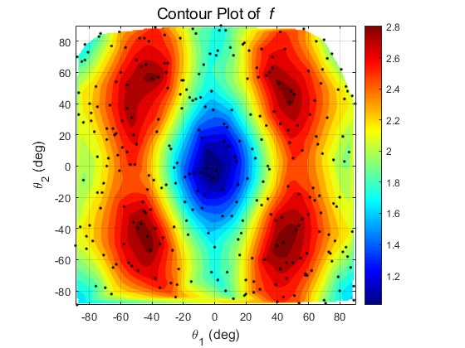
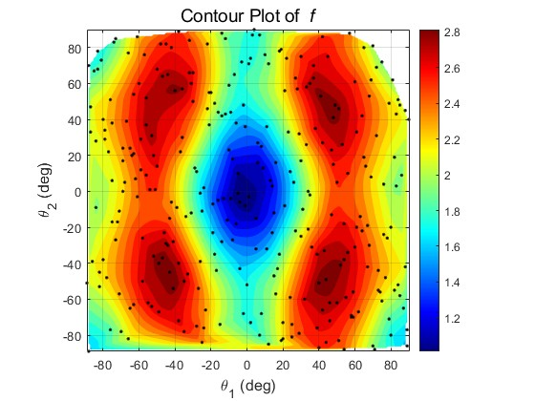
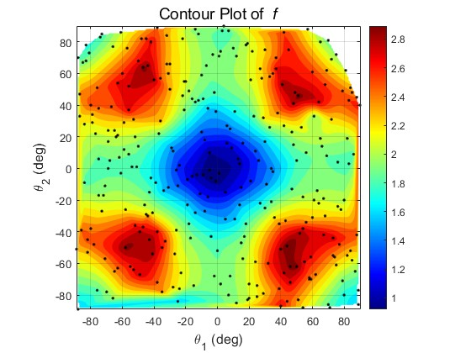
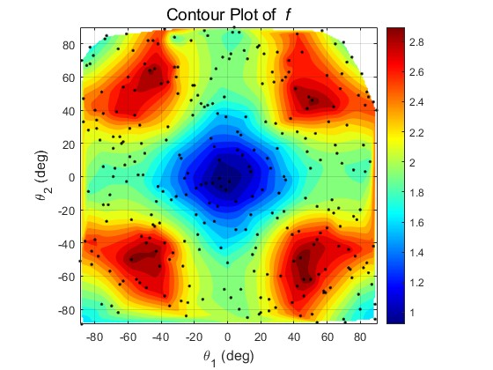
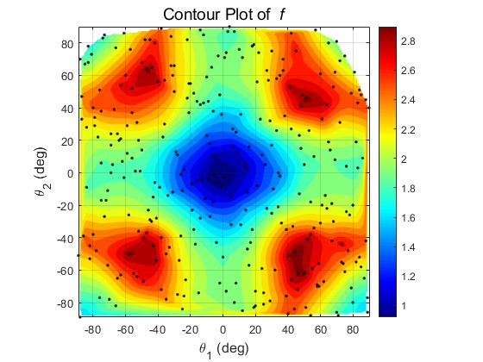
Result Overview: 5 Cases, 2 Surface Patterns
Pattern I: Case 1 & 5
Key contrast
+31.31% vs Quasi
Similar twin-ridge /
Center basin pattern
Case 2 best / quasi = 2.998788 / 2.283682
Design implication
±45º-type angles dominates
Case 1
Case 5
High-performing regions appear away from $θ_{1}$=$θ_{2}$=0º
Pattern II: Case 2, 3 & 4
4-corner peak structure with a low center region
Case 2
Case 3
Case 4

Slide 22



Pattern I: Case 1 & 5
Shared visual pattern
Center basin + Side ridges
Both surfaces favor nonzero ±θ combinations
Highest $f$case 1
Case 1
Case 5
2.894787
Case 5 slightly improves the peak while preserving the same response shape
$θ_{1}$=43.23º, $θ_{2}$=-49.42º
Highest $f$case 5
Quasi | Benchmark | 2.283682
Case 1 | Best | 2.894787
Case 5 | Best | 2.902941
Case 5 | vs Quasi | +27.12%
Case 5 | vs [0/0] | +190.29%
Case 5 | vs Case 1 | +0.28%
2.902941
$θ_{1}$=-43.13º, $θ_{2}$=-44.92º

Slide 23

Pattern II: Case 2, 3 & 4
Case 2
Case 3
Case 4
Cases 2, 3, and 4 highest peak is located near $θ_{1}$=44.13º and $θ_{1}$=-49.42º
Shared visual pattern
4-corner peak with a low center region
Quasi | Benchmark | 2.283682
Case 2 | Best | 2.998788
Case 3 | Best | 2.993270
Case 4 | Best | 2.993247
Case 2 | vs Quasi | +31.31%
Case 2 | vs [0/0] | +199.88%
Case 2 | vs Case 3 | +0.18%
Case 2 | vs Case 4 | +0.19%
All surfaces favor nonzero ±θ combinations
$f$ range
2.9932 – 2.9987
Small variation among cases

Slide 24
Ranking: Optimized Layups vs. Benchmarks
Highest $P_{tr}$
Case 2: 2.998788
$θ_{1}$=44.13º, $θ_{2}$=-49.42º
Improvement vs quasi
+31.31%
15916.5 compare with 12344.8
Improvement vs Case 5
+3.3%
2.998788 compare with 2.902941
All optimized layups cluster around 2.9, while [0/0] and [90/90] are much lower. Therefore, the main result is not only which case wins, but that the optimized ±θ angle family consistently outperforms the basic baselines.

Slide 25
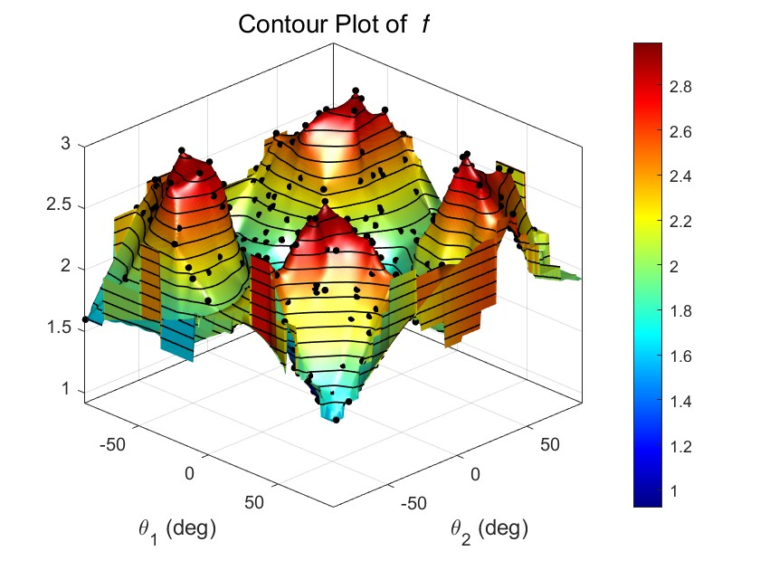

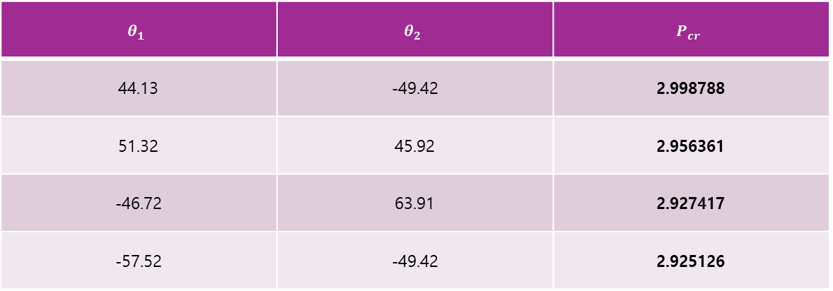

Best Result : Case 2
Best $f$
vs [0/0]
vs Quasi
2.988788
+199.88%
+31.31%
$θ_{1}$=44.13º, $θ_{2}$=-49.42º
2.99x higher than baseline
1.31x higher than quasi-isotropic
Top candidate list
$$θ_{1}$$ | $$θ_{2}$$ | $$P_{cr}$$
44.13 | -49.42 | 2.998788
51.32 | 45.92 | 2.956361
-46.72 | 63.91 | 2.927417
-57.52 | -49.42 | 2.925126
The high-$f$ region occurs around ±45°-type asymmetric combinations, not near the [0/0] or [90/90] baselines.

Slide 26
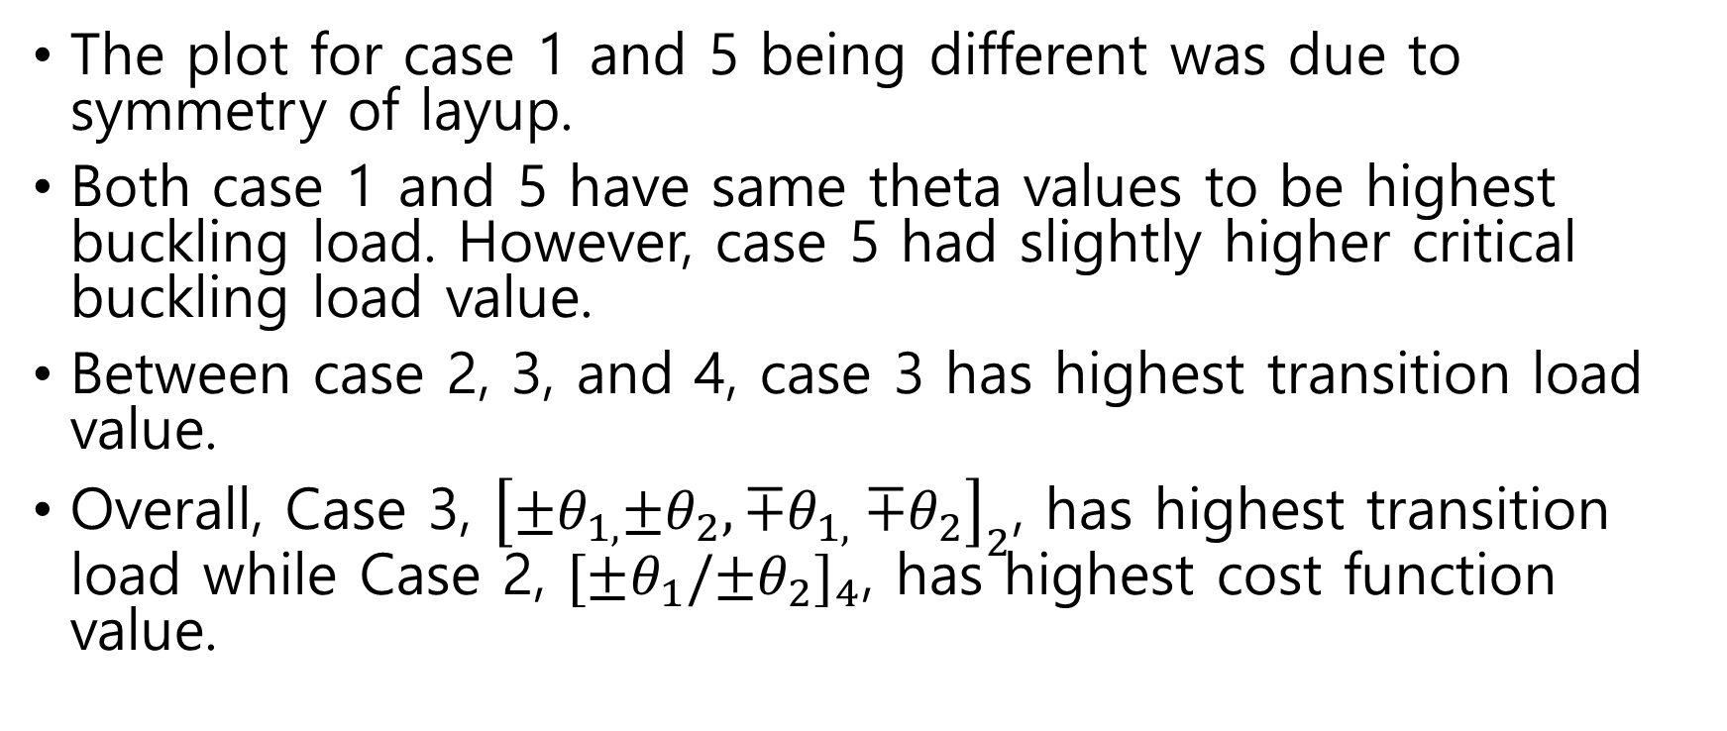
Result
The plot for case 1 and 5 being different was due to symmetry of layup.
Both case 1 and 5 have same theta values to be highest buckling load. However, case 5 had slightly higher critical buckling load value.
Between case 2, 3, and 4, case 3 has highest transition load value.
Overall, Case 3, ${\left[{±θ}_{1,}{±θ}_{2},{∓θ}_{1,}{∓θ}_{2}\right]}_{2}$, has highest transition load while Case 2, ${[±θ_{1}/{±θ}_{2}]}_{4}$, has highest cost function value.

Slide 27
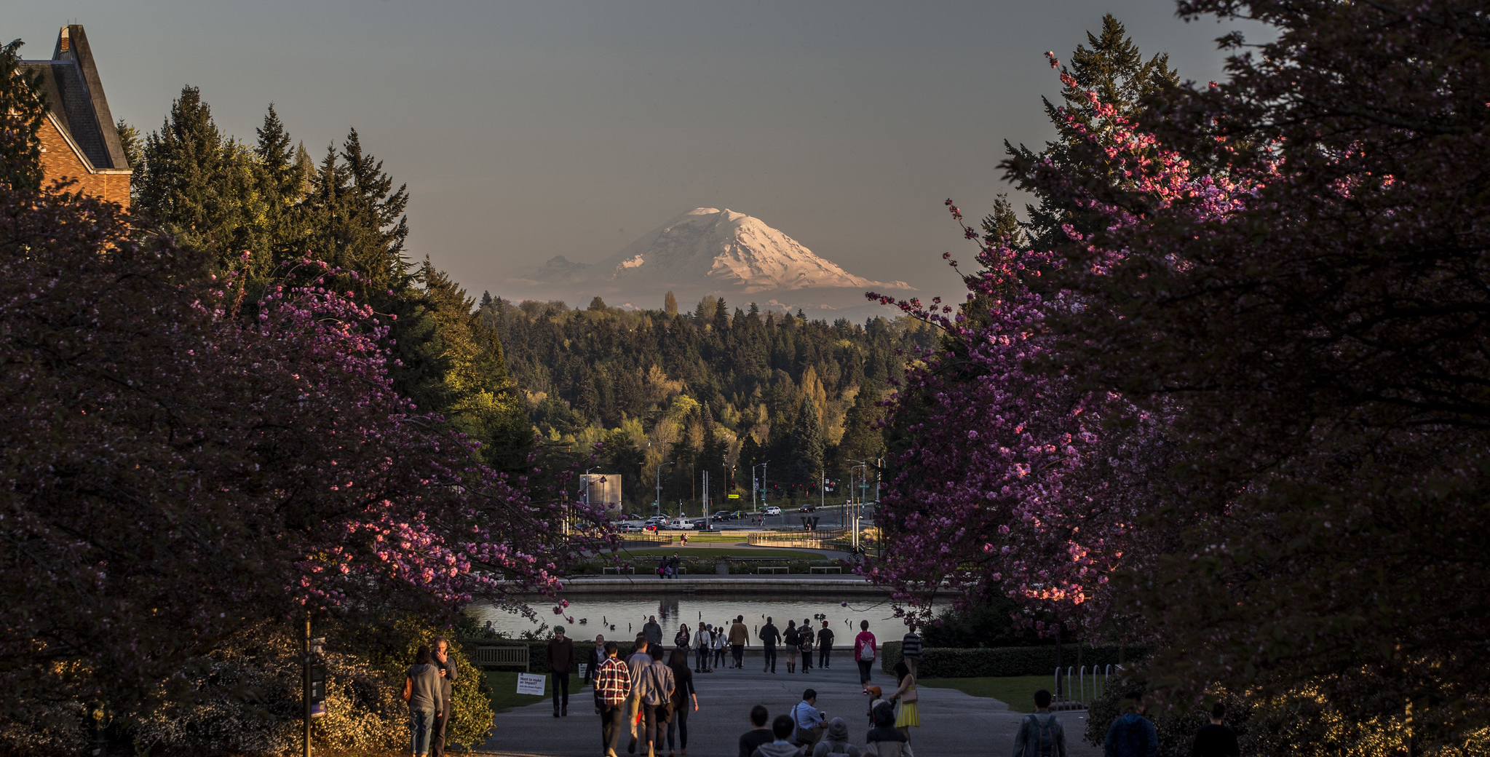
Thank you!!
Questions??

